Slide 1
Pension Design
Peter Diamond
Conférence Évaluation des politiques publiques
December 12, 2019

Slide 2
Issues
Improve DC accumulation
Increased use of indexation:
demography
financial balance

Slide 3
DC accumulation approaches
Wide market access to providers:
Australia, Hong Kong
Small number of dedicated provider firms: Chile
Single central organizer:
Premium Pension, Sweden, NEST, UK, TSP, US
All involve limits on allowable investments, with varying degrees of limitation.

Slide 4
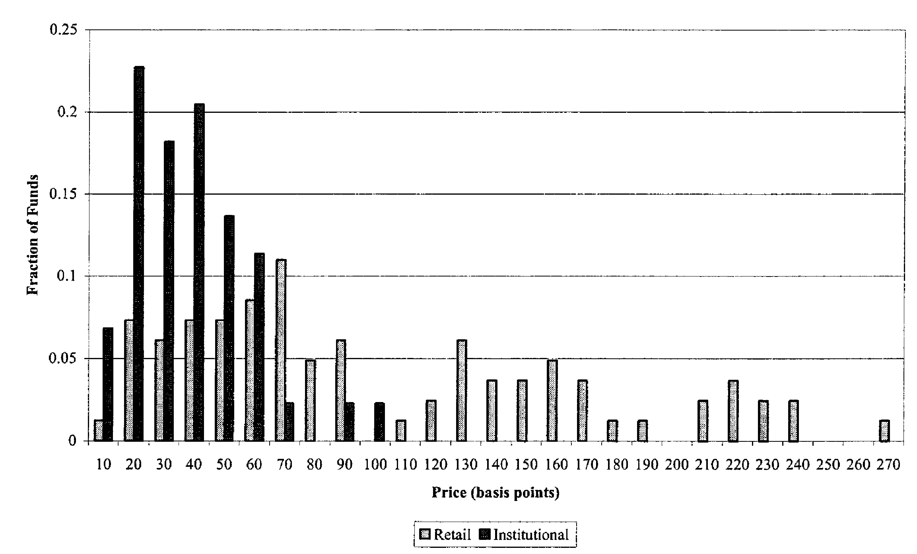
2000 Price Histograms
Retail and Institutional S&P 500 Funds
Source: Figure II., Hortacsu, A. & Syverson, C., 2003. Product Differentiation, Search Costs, and Competition in the Mutual Fund Industry: A Case Study of the S&P 500 Index Funds.

Slide 5
a. Assuming real wage growth of 2.1 percent and a real annual return on investments of 4 percent. With a larger difference between the rate of return and the wage growth rate, the charge ratio with annual management fees is slightly larger, and conversely.

Slide 6
Overview of the Hong Kong
Mandatory Provident Fund System
Findings of the Cost Study probably suggest that it is not enough merely to rely on market forces to drive down fee levels of MPF funds.
Source: Legislative Council Secretariat IN07/12-13, Research Division,

Slide 7
Hong Kong Fund Expense Ratio (FER %)
(as of June 2016)
Fund Type | Number of Funds | Average | Lowest | Highest
Equity | 180 | 1.58 | 0.63 | 2.29
Mixed Assets | 183 | 1.72 | 0.70 | 2.11
Bond | 49 | 1.38 | 0.78 | 1.90
Guaranteed | 27 | 2.08 | 1.29 | 3.75
Conservative | 12 | 0.69 | 0.13 | 1.21
Money Market and Others | 13 | 1.17 | 0.60 | 1.39

Slide 8
Australia Productivity Commission Draft Report, April 2018
Superannuation: Assessing Efficiency and Competitiveness
While some funds consistently achieve high net returns, a significant number of products … underperform markedly
Fees remain a significant drain on net returns.
Members lack access to quality, comparable information to help them find the best products.
Inadequate competition, governance and regulation have led to these outcomes.

Slide 9
Number of Superannuation Accounts Held
Source: Figure B.1, Australian Government, Productivity Commission, How to Assess Superannuation Competitiveness and Efficiency, Draft Report., 2016.

Slide 10
DC accumulation approaches
Wide market access to providers:
Australia, Hong Kong
Small number of dedicated provider firms: Chile
Single central organizer:
Sweden, UK, US
All involve limits on allowable investments, with varying degrees of limitation.

Slide 11
Sweden: Premium Pension in 2016
Government collects contributions and does record-keeping.
A government fund competes with the private funds and provides the default.
843 private funds administered by 108 management companies
  573 equity funds
  97 mixed funds
  41 generation funds
  132 interest funds

Slide 12
Sweden: Premium Pension fees, 2016
Administration cost: 0.07%.
Rebate on the ordinary expenses of the funds, equivalent to a reduction in fund management fees of about 0.49 percentage points.
The capital management fee is 0.23 percent (excluding transaction costs of .05).
AP7 default funds yearly fees:
Equity Fund 0.14% and Fixed Income Fund 0.05%.

Slide 13
UK: National Employment Savings Trust (NEST)
Choice from small number of funds
Employers
    100% online platform
    Employers face compliance costs but no charges
Members
    Annual management charge 0.3%
    Temporary 1.8% charge on contribution (covering startup costs, after which it stops)

Slide 14
U.S.: Thrift Savings Plan Funds
Government Securities Investment (G) Fund
Fixed Income Index Investment (F) Fund
Common Stock Index Investment (C) Fund
Small Capitalization Stock Index (S) Fund
International Stock Index Investment (I) Fund.
and
Lifecycle funds, which are invested in the individual TSP funds—G, F, C, S, and I.

Slide 15
Issues
Improve DC accumulation
Increase use of indexation:
demography
financial balance

Slide 16
Indexing for demographic changes
Germany: Pension point value is indexed to gross wage growth adjusted for changes in the contribution rate and changes in the dependency ratio.
Netherlands: If you were born after 30 September 1957, your exact AOW pension age will be decided about 5 years in advance. As from 2022, it will be linked to life expectancy.
Sweden, Italy NDC: Life expectancy affects initial benefit level
US proposal (Diamond and Orszag): Life expectancy affects both initial benefit levels and contribution rates to share increased 75-year projected cost

Slide 17
Indexing for financial balance in national plans
Sweden Inkomstpension: If measured assets are less than measured liabilities, reduce the indexation of pensions in payment and of pension balances.
Canada Pension Plan: If the contribution rate projected to be required to sustain the CPP over the next 75 years is higher than the legislated contribution rate, and no agreement is reached, then the contribution rate is increased by ½ of the excess over three years and benefits are frozen until next review in 3 years.

Slide 18
Indexing for financial balance in an employer plan
New Brunswick Public Service Pension Plan
If the 15 year open group funding ratio falls below 100% for two successive years actions are to be taken by the Board of Trustees:
A contribution increase of up to 3% of earnings (1.5% each for employee and employer contributions) until such time as the open group funded ratio reaches 110% and the funding goal under regulation is met.
Future and present benefits can be reduced:
    Change the rules for non-vested members to a full actuarial reduction for early retirement; then
    Reduce base benefit accrual rates for future service by no more than 5%; then
    Reduce base benefits on a proportionate basis for all members for both past and future service in equal proportions.

Slide 19


